Slide 1
I’m the Biggest Thing
in the Ocean
by Kevin Sherry

Slide 2
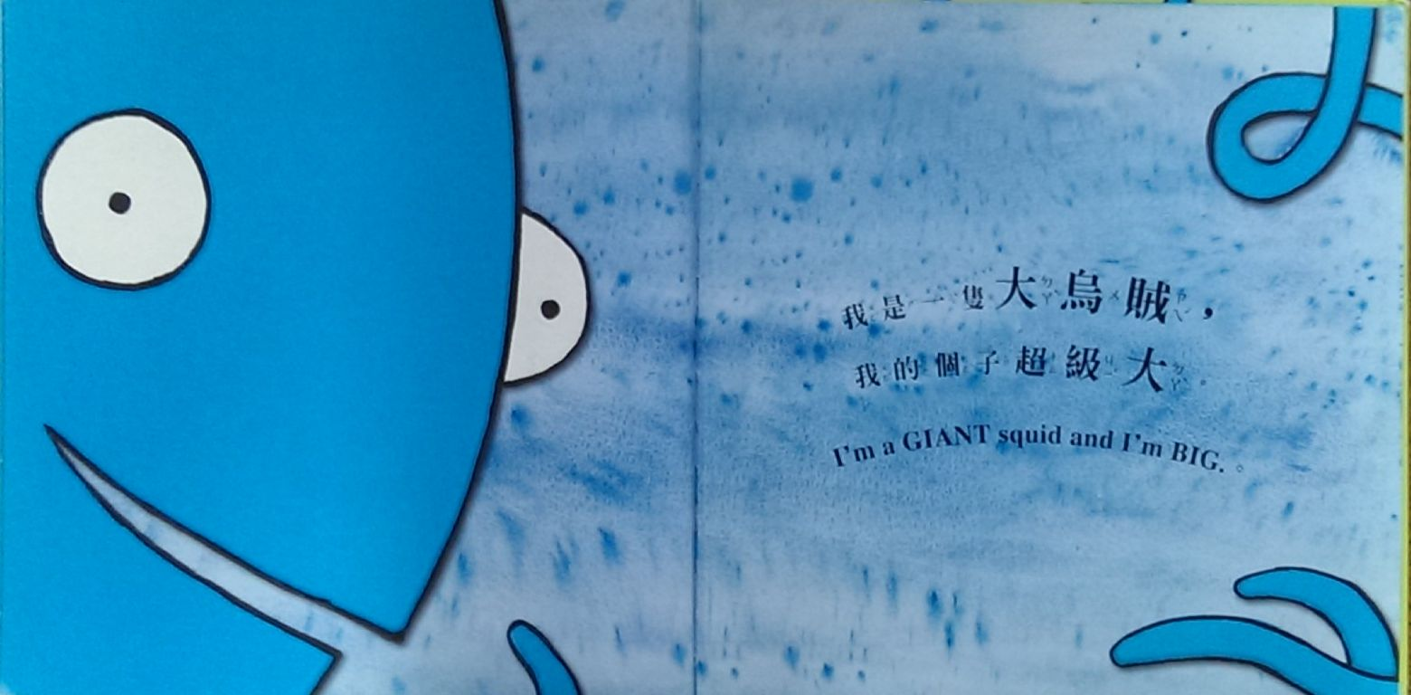
I’m a GIANT squid
and I’m Big.

Slide 3
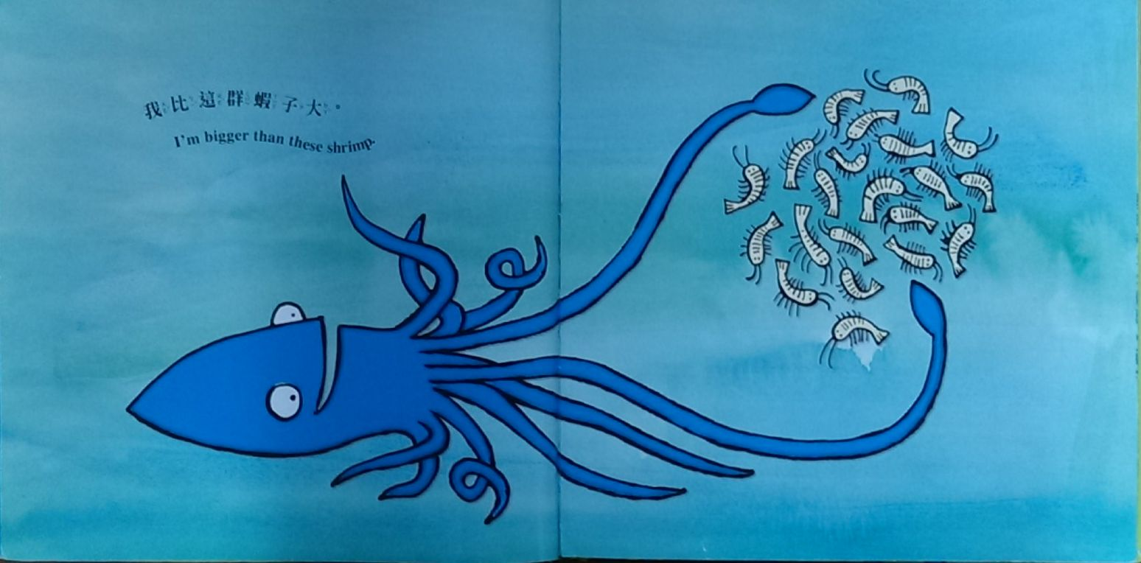
I’m bigger than
these shrimp.

Slide 4
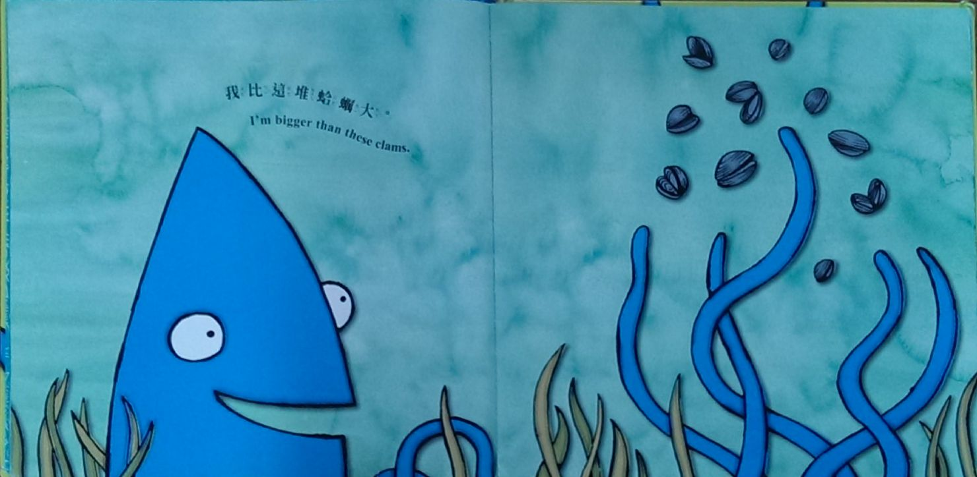
I’m bigger than
these clams.

Slide 5
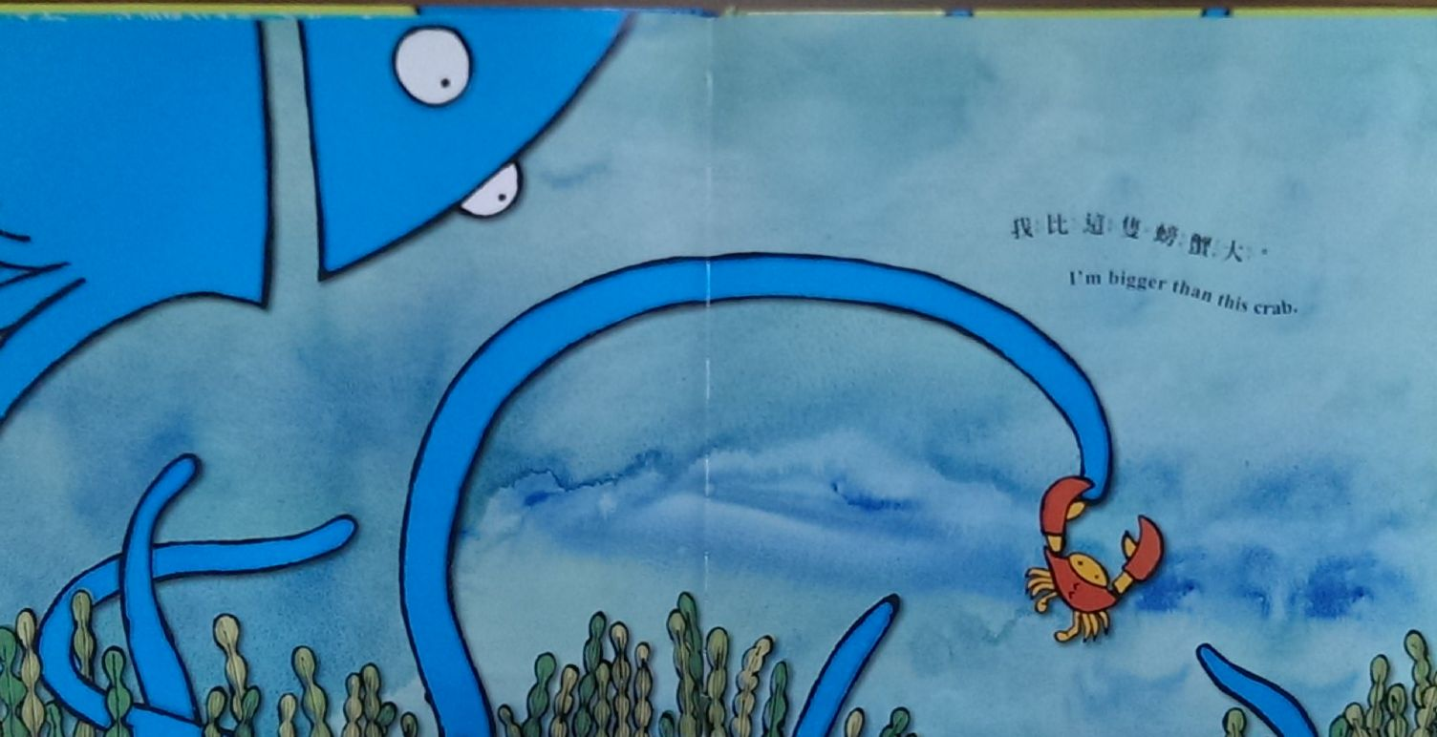
I’m bigger than
this crab.

Slide 6
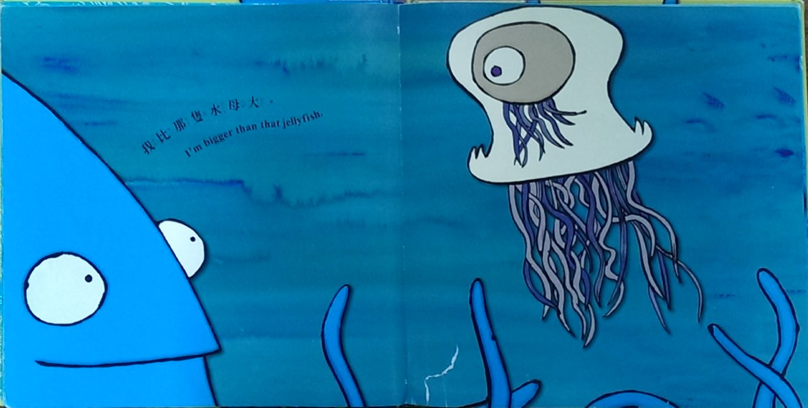
I’m bigger than
that jellyfish.

Slide 7
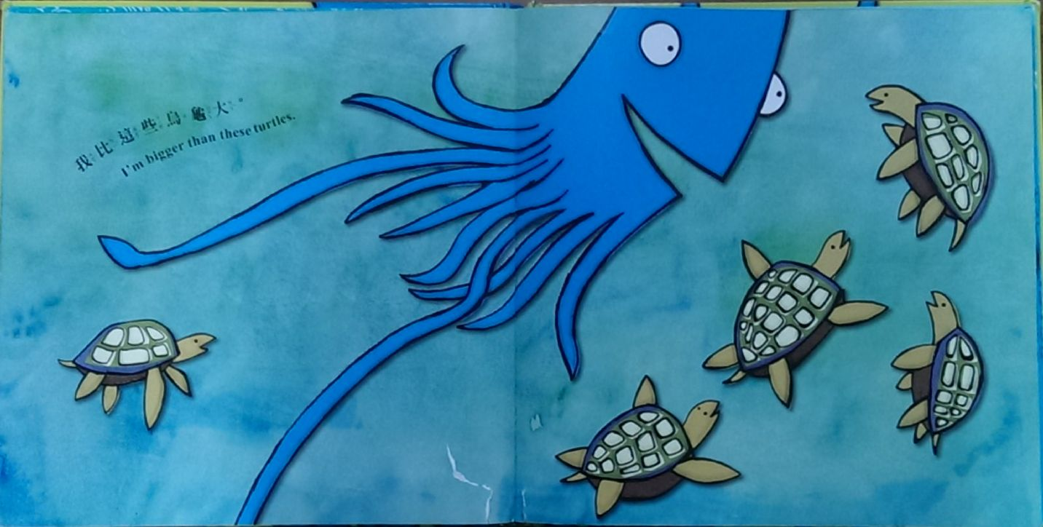
I’m bigger than
these turtles.

Slide 8
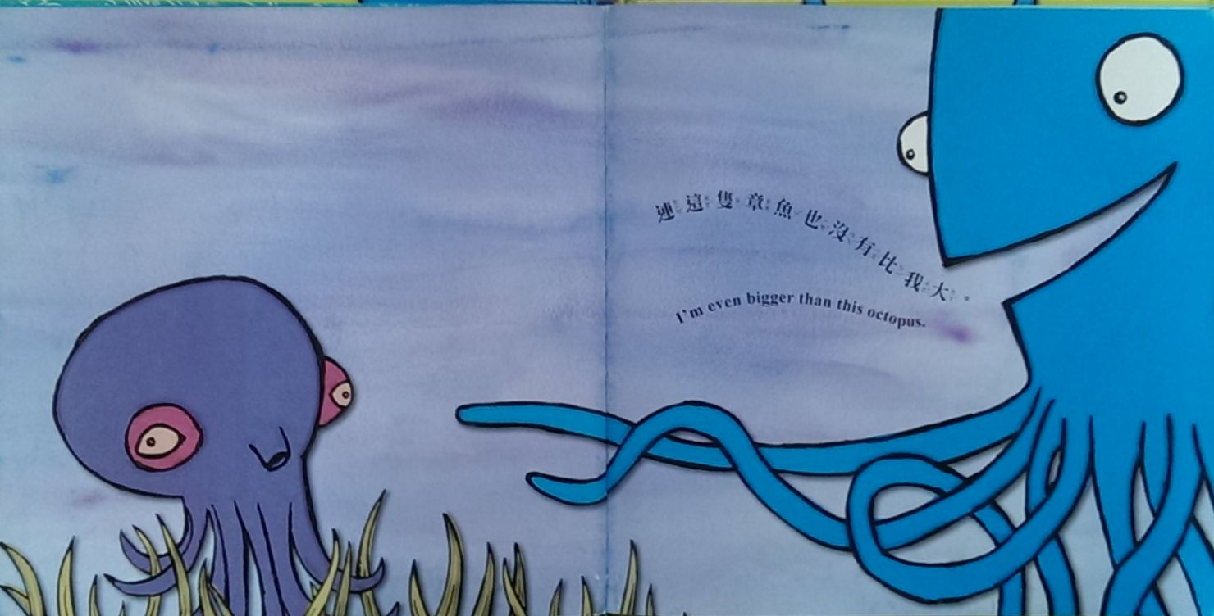
I’m even bigger than
this octopus.

Slide 9
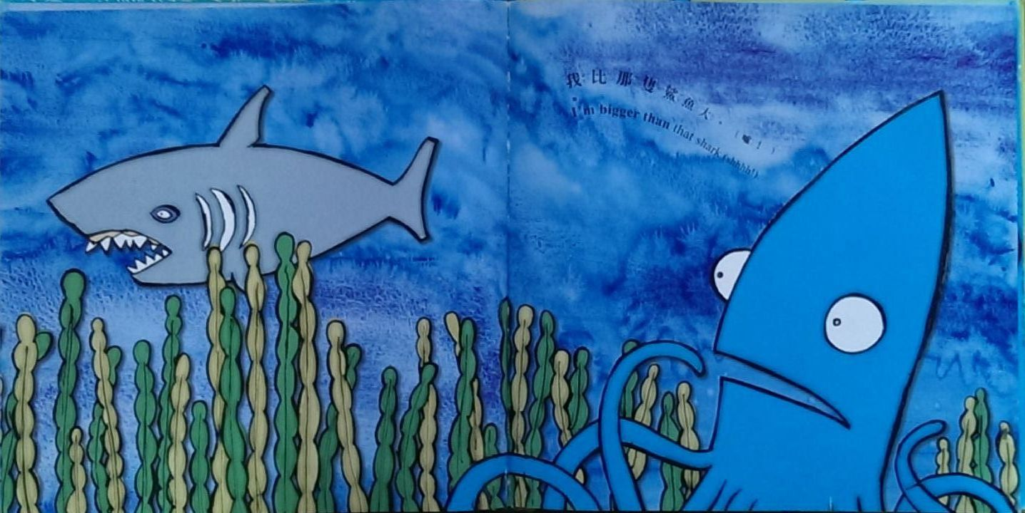
I’m bigger than
that shark (shhhh!)

Slide 10
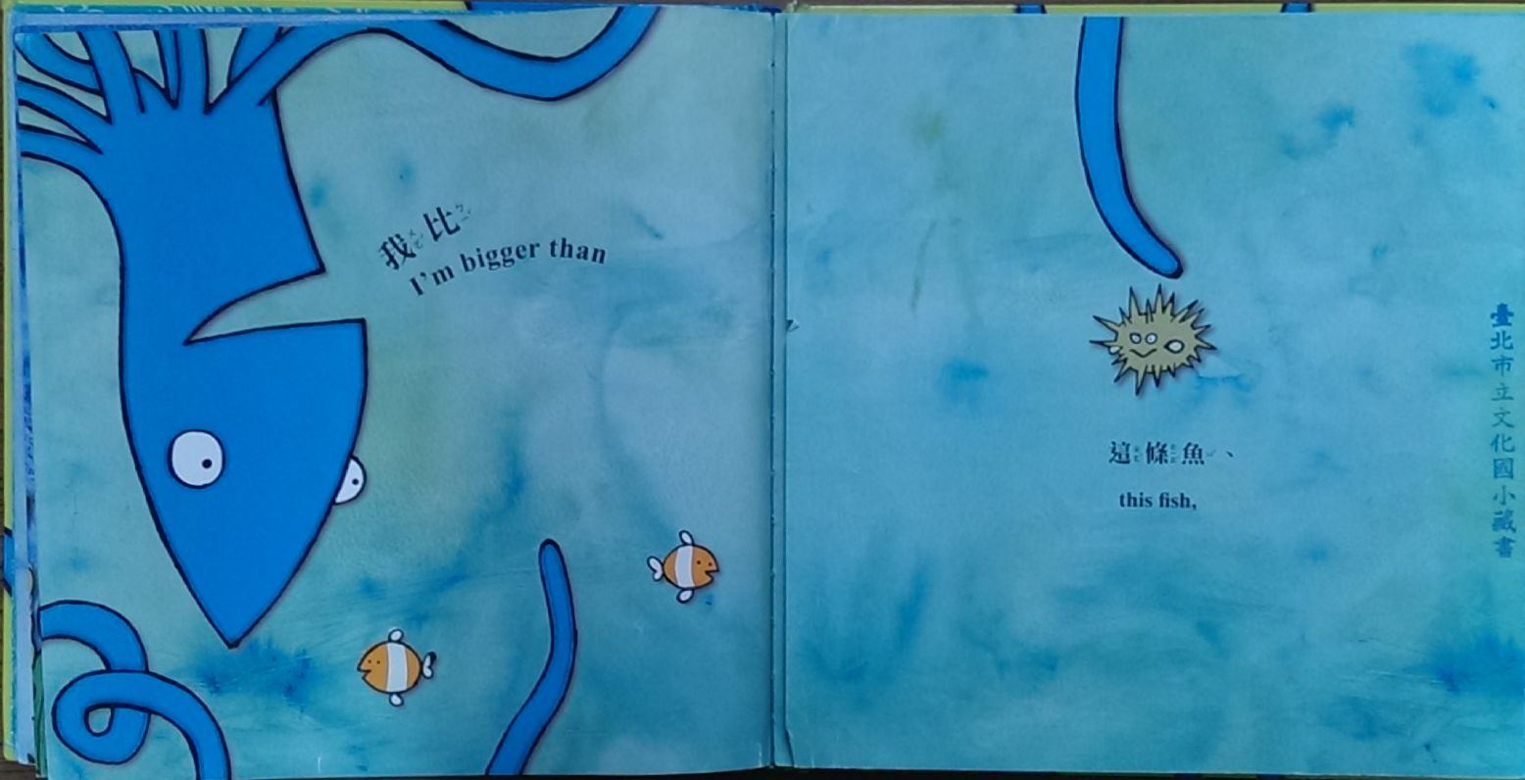
I’m bigger than
this fish

Slide 11
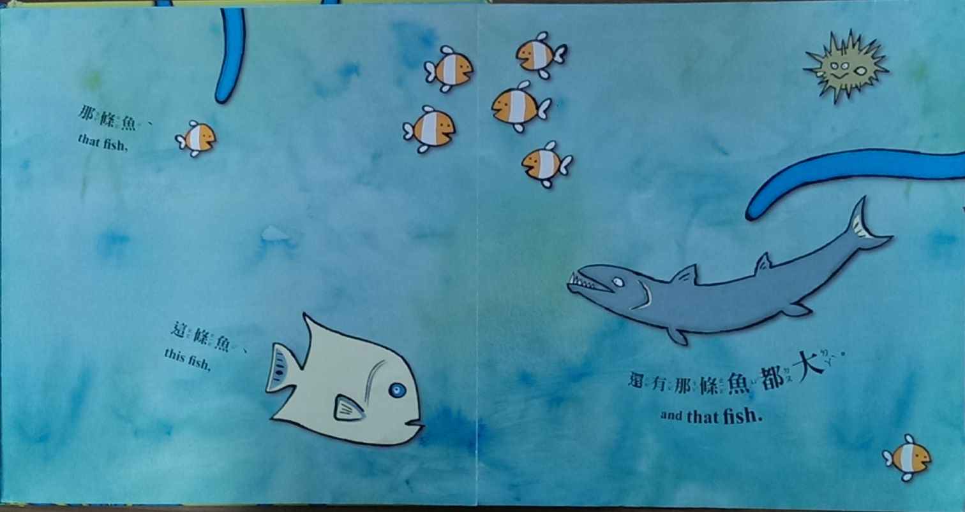
that fish
this fish
and that fish

Slide 12
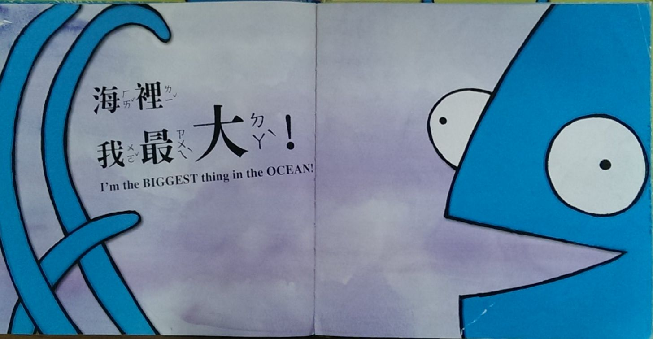
I’m the Biggest thing
in the OCEAN!

Slide 13
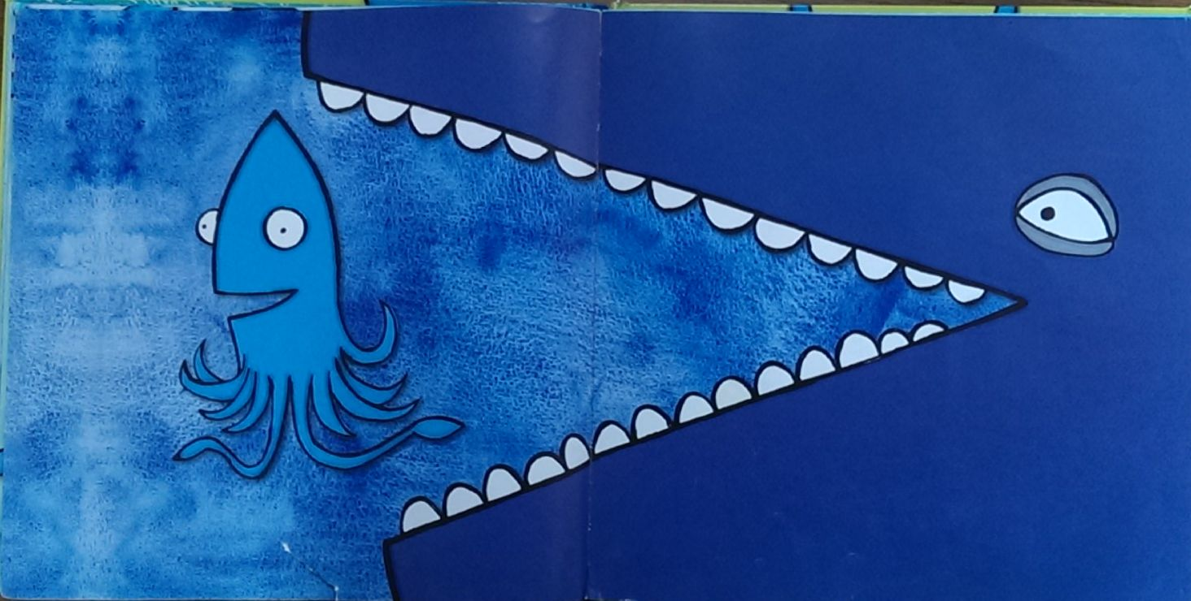

Slide 14
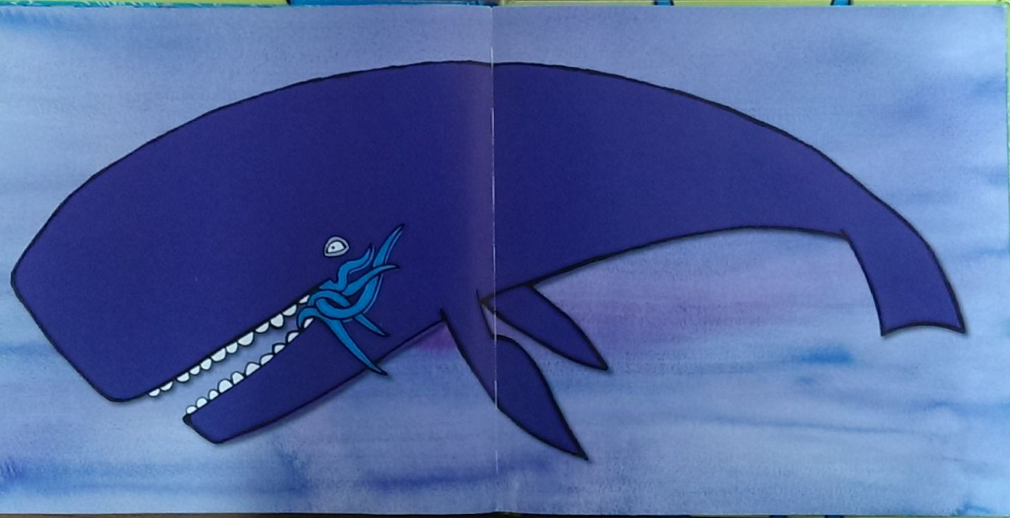

Slide 15
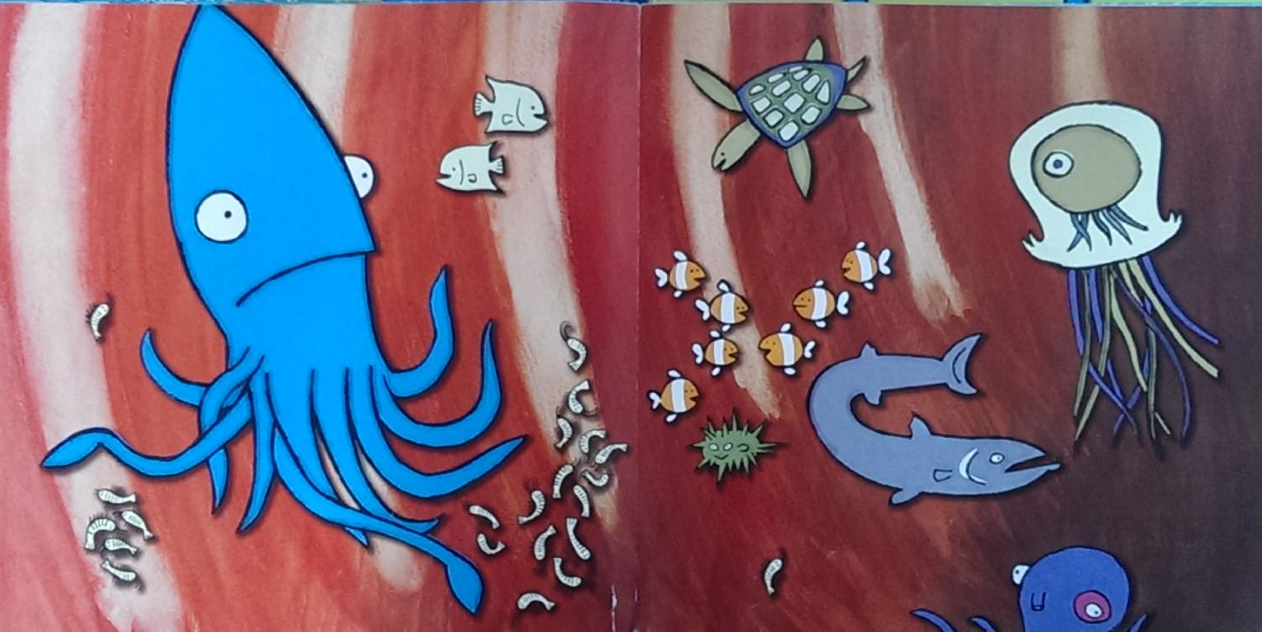

Slide 16
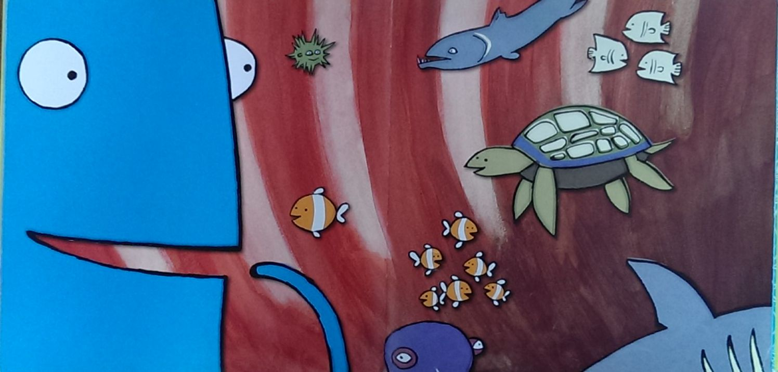

Slide 17
I’m the
BIGGEST THING
in this WHALE !

Slide 18
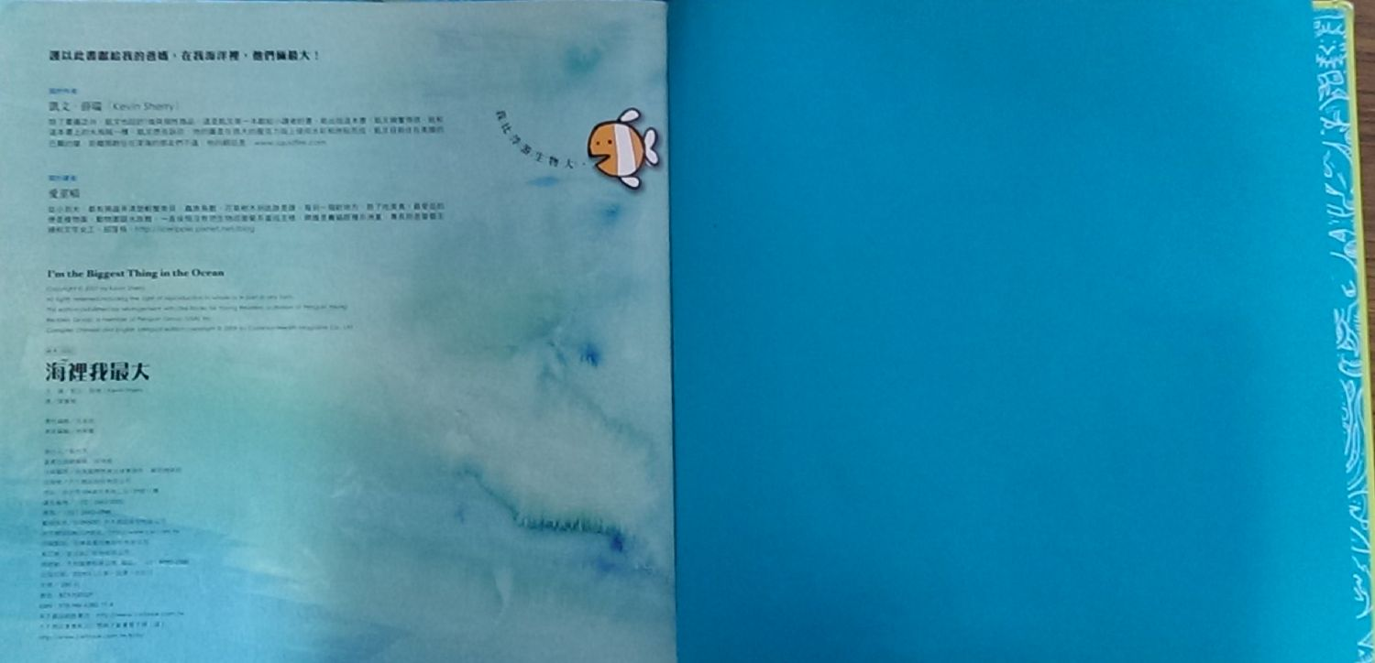
I’m bigger
than the
plankton!

